Slide 1
Advance Java
Servlet Session Management
LEVEL – PRACTITIONER

Slide 2
About the Author
Created By: | Renjith(t-renjith)/ Shanmu (105110)
Credential Information: | Trainer, Sr Architect
Version and Date: | 1.0, January 4’th 2012
Cognizant Certified Official Curriculum
Notes:
For tde animators:
tdis screen content needs to be rendered in tde flash, no animations needed.

Slide 3









Icons Used
Hands on Exercise
Questions
Tools
Coding Standards
Test Your Understanding
Case Study
Best Practices & Industry Standards
Demonstration
Workshop

Slide 4
Objectives
After completing this chapter you will be able to:
What is HTTP session
Understand Session Management Techniques like,
URL rewriting
Hidden Fields
Cookie
Session Object

Slide 5

A Problem statement
Tim was developing an application where he has a requirement to display the Login name used during login across all the pages in the application. Knowing that HTTP is a stateless protocol he was wondering how he can achieve it?
Guess how Tim would have achieved it?
He used session management.
5

Slide 6
So what is Session Management?
Session Management is a mechanism for maintaining state across multiple HTTP requests. This is managed by the Web container.
In Simple words it is a technique to hold some values passed by user across multiple HTTP requests arising out from a single browser instance.
How Tim solved the problem? Tim used session to store the Login name, thus it helped him to preserve the login name and access it from all the pages.
Session life cycle is managed for each web browser instance opened and it exists till the browser is closed (or) till the session time outs (set in the server configurations).

Slide 7
Back to the problem statement
Lets See How Tim would have developed it using Session management.
Scenario: The requirement is the user logs in using a Login page, the user name used during login should be displayed in home page and any other page requested by the user. NOTE: User name is not a parameter in the remaining pages.
Lets see how Tim would have achieved it.
7

Slide 8
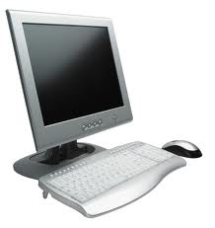

Servlet without session tracking
Tim Log in the application passing user Name (R1)
Web container
LoginServlet
Login servlet responds back.
Tim Access Home page (R2)
HomePage
Servlet
Tim opens a
web browser
Home page displayed but without user name.
The second request for Home page, the user is NOT passing user name nor the value from request R1 is stored anywhere .
So home page cannot display the user name.

Slide 9
Servlet with session tracking
Web container
Tim Log in the application
Servlet stores the user name in session
LoginServlet
Session
Login servlet responds back.
User Name = “Tim”
Tim Access Home page
HomePage
Servlet
Tim opens a
web browser
Though the user name is NOT in the request it can print the user name by accessing the session.
Home page displayed with user name displayed.
In the above example if Tim opens a new browser and access Home page servlet the user Name cannot be accessed since a new HTTP Session object is created.

Slide 10
Need for Session ?
HTTP is a stateless protocol. So if developers need to develop pages where he needs to maintain the application user’s state across multiple request he can use session.
For Example, he can store the following information,
Login Name.
Users state/ City.
User ID number. Etc.

Slide 11
How is Session Tracked for a User ?
Each user session is tracked by unique ID called JSESSIONID
This is similar to how a employee is identified in a organization using employee Id.
JSESSIONID will be generated the first time the user visits a site.
JSESSIONID will be generated for each browser instance.
Example: When a user Tom access a site www.cognizant.com a JSESSIONID will be created say “101”. When Tom opens another browser and access the same site www.cognizant.com a new JSESSIONID , say “102” will be created to track that session.
For subsequent requests to the same site this ID will be used to track the user using tracking techniques like cookie, encoded url etc.

Slide 12
Session management techniques
The following are the session management techniques. These are used for managing the data’s between pages of the user in a session.
Hidden Fields
URL Rewriting
Cookies
Session Object
Let’s look at these one by one.

Slide 13
Session Management Technique # 1 : Using Hidden Field
What is a Hidden Field?
Hidden fields are nothing but normal HTML form element with type Hidden to store the user data across HTTP request.
How it is used for session tracking?
The user state to be preserved across HTTP request can be stored as a hidden elements in the HTML pages which can be read from other pages.
An Example:
Taking the Tim example, the user name can be written in a hidden field and sent across pages to display the user name.

Slide 14
Hidden Field Implementation?
Syntax :
<input type=“hidden” name = “name” value=“value”/>
Example : Taking the Tim example,
<input type=“hidden” name = “userName” value=“Tim”/>
If the user name is set as a hidden field in the HTML pages, it can be accessed by the servlets and sent back in the HTML response.
How to access Hidden Fields Values?
Hidden field values can be read using the request.getParameter(“Key”) method.

Slide 15
Lend a hand: Hidden field
This demo shows the associates how to use hidden fields for maintaining state information across pages in an application.
Scenario : Let us create registration module in which the registration process spans across two pages. First one is the personal details page and the second is the professional details page. The entered details in personal and professional details page should be printed in registration success page.
Components :
personalDetails Html : - Page for entering the personal details
ProfessionalDetails Servlet :- Acts as the action servlet for personalDetails and also renders the form for entering professional details.
RegistrationSuccess servlet :- Action servlet for professional details which reads all the parameters and displays the details to the user.

Slide 16
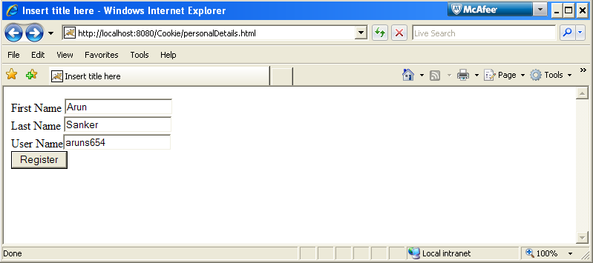
Lend a Hand : Screen Shot – personal Details HTML

Slide 17
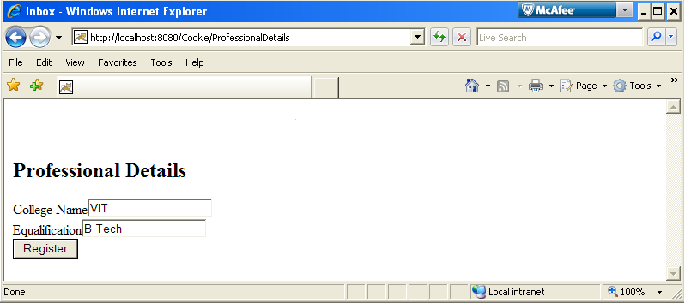
Lend a Hand : Screen Shot – Professional Details
NOTE: You will not notice the first name, last name and user name in the HTML page. Right click the browser and click view source, you can see these fields set as hidden variables.
“Hidden Fields Will not be displayed in the response it is just a mere container to store the values and share it across pages”

Slide 18
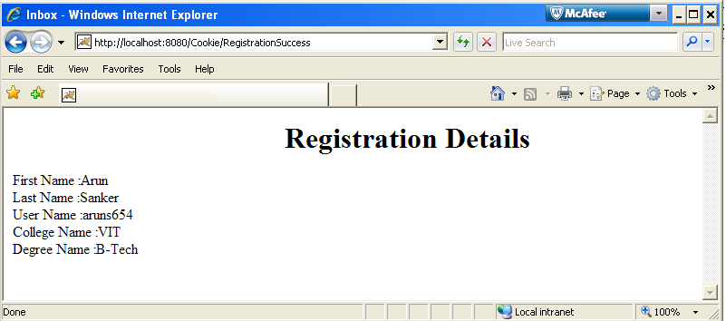
Lend a Hand : Screen Shot - Registration Success
NOTE: The first name, last , user name entered in the personal details HTML is tracked till the registration Details success page.

Slide 19
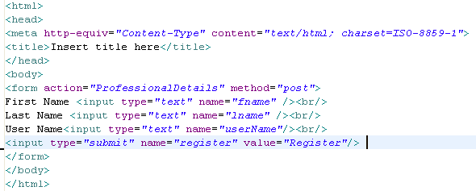
Lend a Hand : Developing Personal Details HTML
Develop the personal details HTML page as mentioned below,
It should have the following fields,
First Name
Last Name
User Name , submit action should be the professionalDetails servlet.

Slide 20
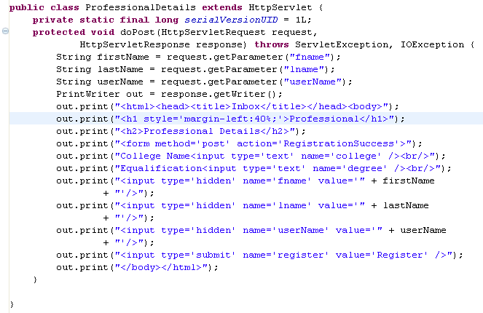
Lend a Hand : Developing Professional Details Servlet
Develop the professional details servlet which will display the following fields,
College Name – Text box
Qualification - Text box, submit action will be the RegistrationSuccess servlet.
NOTE: The first, last and user name needs to be displayed in the success page to make it happen we need to store these fields as hidden fields in the response of this page.
Values written as hidden fields

Slide 21
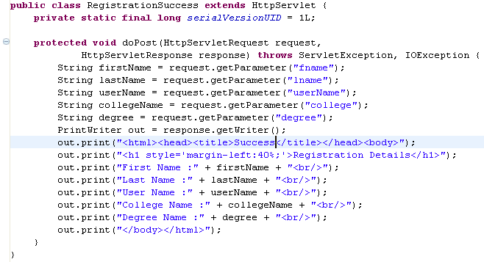
Lend a Hand : Developing Registration Success Servlet
This is the success page this should read all the form elements including hidden variables and display the success message as follows.
Reads the hidden field values

Slide 22
Lend a Hand- Deploy and Run
Step 1 : Deploy and run the application
Step 2: Call personalDetails.html from the browser
http://localhost:8080/Cookies/personalDetails.html
Enter the requested details.
Step 3: Click Register and enter the professional details.
Step 4: Click Register and system should display the registration success page with the personal and professional details.

Slide 23
Pros and Cons of hidden field
Pros :
Does not consume any memory space in web server as it is stored in the HML pages.
Works even if users disable cookies
Cons:
Can be used only with HTML forms.
This is not secured.
Very complex to develop and maintain as all the pages which needs state information needs to be implemented for the hidden fields.

Slide 24
Session Management Technique # 2: URL Rewriting
What is URL rewriting?
The mechanism by which the user state or information's are appended to the URL for tracking the state/session of the user.
Example: Taking the Tim example, the userName is set in the URL.
http://www.domain.com/SuccessServlet?userName=“Tim”& location=“India”
Where, userName and location are user information set as parameter in the URL.

Slide 25
Lend a Hand : Demo on URL rewriting
This is a demo for the associates on how URL rewriting can be used as a session management technique.
Scenario: In a web based mail application user logins with his user name and password. The subsequent pages inbox/Sent items he visits after login should have a welcome message with his username printed. We will see how this can be achieved using URL rewriting.
Components to be Developed:
login.html : Login page
LoginServlet : Action page for the login page, redirects the request to inbox.
Inbox Servlet : The inbox of the user should have a link pointing to sent items.
Sent Items Servlet : The sent items page for the user should have a link pointing to inbox.
NOTE: The user name & location as part of the LoginServlet request should be available when the inbox and sent items servlets are accessed from the links mentioned in point # (2) & (3)

Slide 26
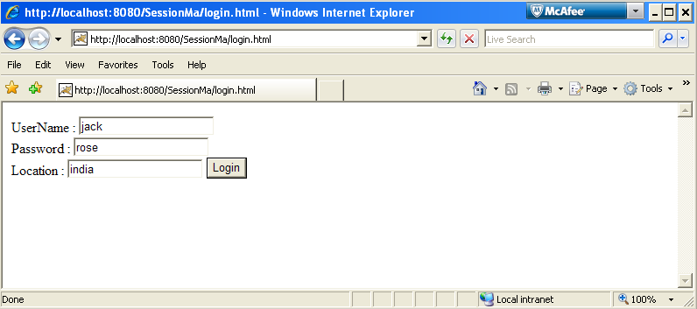
Lend a Hand : Screen Shot login.html

Slide 27
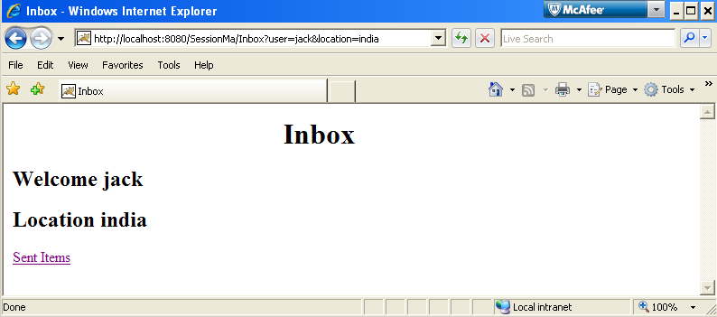
Lend a Hand : Screen Shot Inbox
Note the value appended to the URL

Slide 28
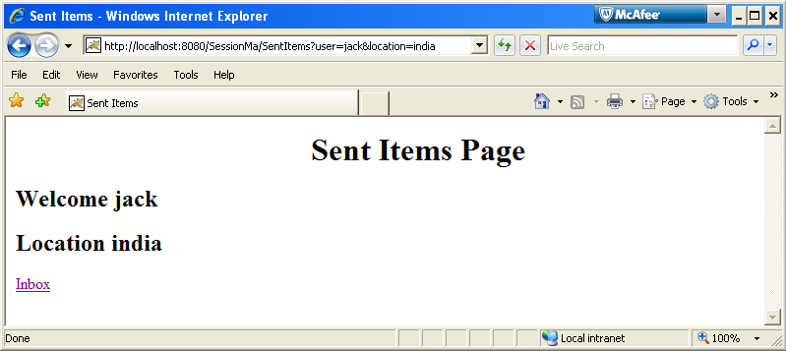
Lend a Hand : Screen Shot Sent Items

Slide 29
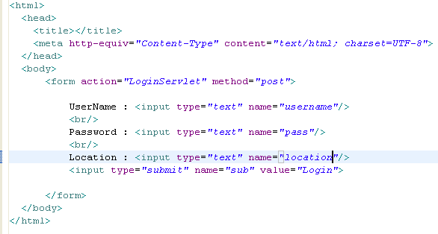
Lend a Hand : Develop Login html
Develop the Login HTML as mentioned below, It should have the following fields,
User Name
Password
Location , submit action should be the LoginServlet.

Slide 30
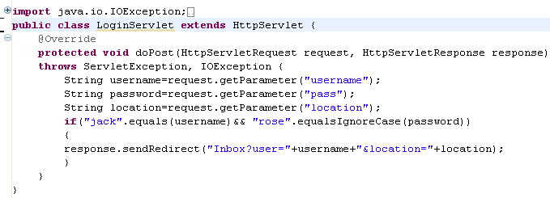
Lend a Hand – Develop Login Servlet
Develop the login servlet which redirects the request to Inbox servlet and appending the data user name and location in the URL as show below.
Note username and location are appended to the URL and separated by an ampersand.

Slide 31
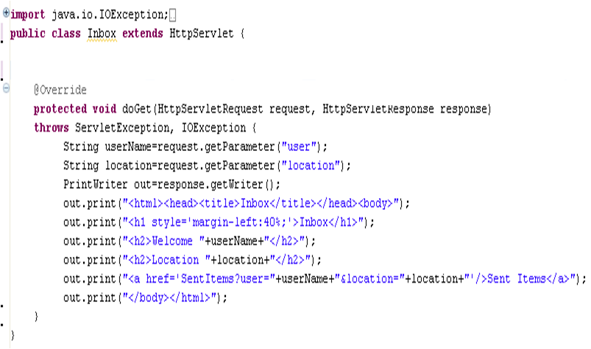
Lend a Hand – Develop Inbox Servlet
Develop the inbox servlet which reads the user name and password from the URL and creates a sent items link with the user name and location set as parameter.
Reading parameters from URL
Note username and location are appended to the URL and separated by an ampersand.

Slide 32
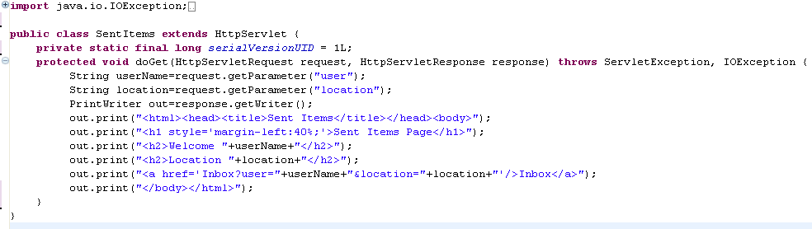
Lend a Hand – Develop Sent items servlet
Develop the sent item servlet which reads the user name and password from the URL and creates a inbox link with the user name and location set as parameter.
Note username and location are appended to the URL and separated by an ampersand.

Slide 33
Lend a Hand – Deploy and Run
Step 1 : Deploy the application.
Step 2: Call login page from browser.
http://localhost:8080/Cookies/login.html
Step 3 : Enter the details in login.html and press login. You will be redirected Inbox page. Look at the URL for the parameters set and the welcome message displayed.
Step 4 : Click Sent Items link and you can notice the url having the parameter and the message being displayed.

Slide 34
Pros and Cons of URL rewriting
Pros :
Every data is appended on the URL => easy to debug.
Works even if users disable cookies
Cons :
URL length is a limitation, so we cannot store information beyond a limit.
The URL contains data so it is not secured.
Difficult to maintain in large application since in each page the URL should be rewritten to carry the data.

Slide 35

Session Management Technique # 3: Cookies
What is a Cookie?
Simple piece of textual information (in key value pair format) stored on the client (browser machine).
Cookies information are returned to the server with every request from the client.
How cookies are identified in client machine?
The browser matches the cookies present with the site URL. If a match is found, that cookie is returned with the request.

Slide 36
Steps for Using Cookie
Step 1 : Create the cookie object
Step 2 : Set the cookie object to the HTTP response
Step 3 : Read the cookies from the next HTTP request
Step 4 : Validate the cookie value for session tracking

Slide 37
How to Create Cookie ?
Cookies are Created using the Cookie class of Servlet API.
Syntax :
Cookie cookie = new Cookie(identifier,value);
Where identifier is the name of the state information, value represents the value of the state.
Example : Taking the Tim example,
Cookie cookie = new Cookie(“User Name”,”Tim”);

Slide 38
Setting Cookies to the HTTP Response.
How to Set Cookies to the response?
Since cookies are stored at the client, cookies are set to the response object and send to the client using the addCookie() method of the HttpServletResponse interface.
Cookie cookie=new Cookie(“User Name”,”Tim”);
response.addCookie(cookie);

Slide 39
Reading Cookie Values from request.
Cookies stored in the client will be sent to the server along with the HTTP request, each time the client requests a page.
The cookies in request object can be read using the getCookies() of the HttpServletRequest interface.
Cookie[] cookieList = request.getCookies();
cookieList array can be traversed to read all the cookie value associated with particular client session.

Slide 40
Lend a Hand - Cookie
In this demo the associates get familiarized with the technique of session management by using cookies.
We will use the same web mail application that we have used in the URL rewriting demo and see how cookies can serve the purpose.
Components :
login.html :- Login page
LoginServlet :- Action page for the login page
Inbox Servlet :- The inbox of the user
SentItemsServlet :- The sent items page for the user.

Slide 41
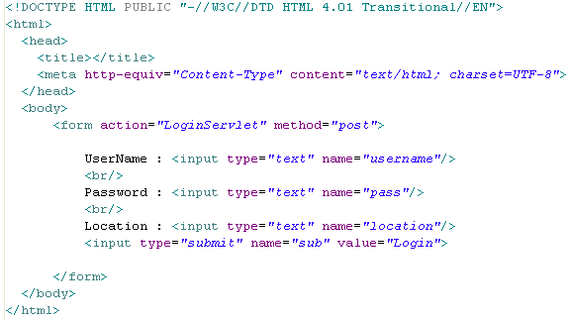
Lend a Hand : Develop Login Html
Develop the Login HTML as mentioned below, It should have the following fields,
User Name
Password
Location , submit action should be the LoginServlet.

Slide 42
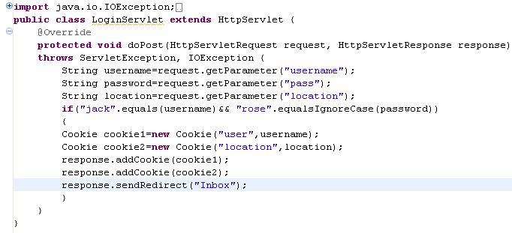
Lend a Hand: Develop a Login Servlet
Develop the login servlet which adds a cookie to the response with the user name and location and redirect the request to Inbox servlet.
Creates two cookie objects
Adds the cookie objects to the response for sending to the client

Slide 43
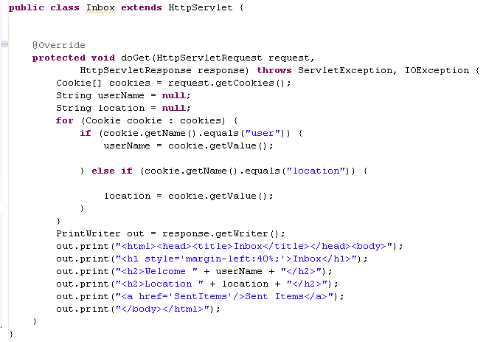
Lend a Hand: Develop a Inbox Servlet
Develop the inbox servlet which reads the user name and password from the cookies and creates a sent items link.
Reads all cookies associated with client
Iterate through the cookies and read the cookie user name and location values.
Reads the cookie values and sets in the response for display.

Slide 44
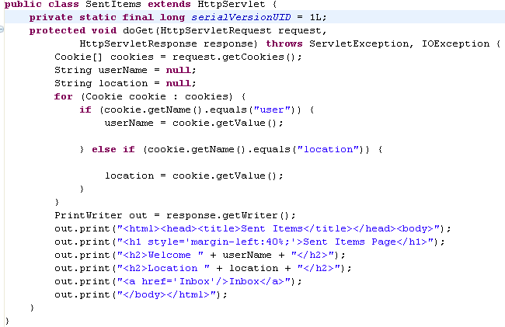
Lend a Hand: Develop Sent Items Servlet
Similar to inbox servlet the sent item servlet read the values from the cookies and display the user name and location.

Slide 45
Lend a Hand: Deploy and Run
Step 1 : Deploy the application.
Step 2: Call login page from browser.
http://localhost:8080/Cookies/login.html
Step 3: Enter the details in login.html and press login. You will be redirected Inbox page where the welcome message is displayed with the location and user name.
Step 4 : Click Sent Items link and you can see sent items page where the welcome message is displayed with the location and user name.
NOTE: The user name & location parameters are NOT in the URL rather they will be part of the cookies which are stored in client machine and sent every time to the server as part of the HTTP request.

Slide 46
Pros and Cons of using Cookie
Pros:
Easy to develop and maintain.
Less overhead to server since data is stored in the client.
Minimizes the server memory usage.
Cons:
Size and number of cookies stored are limited.
Stored as plain-text in a specific directory, everyone can view and modify them. So it is not secured.
It is browser dependent, so if client has disable cookies this can lead to erroneous behavior of the application.

Slide 47
Session Management Technique # 4: Http Session Object
What is a Session Object?
Session Object is a container used for storing user states in server.
The session objects lifecycle is maintained by web container.
The Servlet API HttpSession interface provides features for Session tracking.
HttpSession objects are objects used for storing client session information.

Slide 48


Servlet with session tracking
Lets consider the web mail application scenario and see how session management works.
Assume Ron & Tim access the web mail application
Web container
2. Login servlet creates
Session for Tim
HTTP Session
1. Tim Log in the application
Session Object #1
User Name = “Tim”
Location = “Chennai”
Login
3. Tim access Inbox
Tim
Inbox
4. Inbox uses Session
information to display
the name
Session Object #2
User Name = “Ron”
Location = “Chennai”
5. Tim Access Sent Item
Sent Item
6. Sent Item uses Session
information to display
the name
Ron
Now when Ron logs in a new “Session 2” will be created (Similar to step 2) and his user name and city will be stored in session. Steps 3~6 will be similar to Tim’s steps.

Slide 49
How are Session value stored?
Session Value Storage?
Session values are stored in key/value format similar to Map interface.
Each value would have a name bound to it for retrieving the values.
Example: Assuming the same web mail application scenario, Tim’s session object will look as below.
Where user Name and Location are Key.
Tim & Chennai are the respective values.
Attribute Name | Value
User | Tim
Location | Chennai

Slide 50
Http Session Important API’s
Method | Description
String getAttribute(String attributeName) | Returns the object/value bound with the specified attribute name in this session, or null if no object is bound under the name.
Enumeration getAttributeNames() | Returns an Enumeration of String objects containing the attribute names of all the objects bound to this session.
long getCreationTime() | Returns the time when this session was created
String getId() | Returns a string containing the unique identifier assigned to this session which is the jsessionID.
long getLastAccessedTime() | Returns the last time the client accessed the session object.

Slide 51
Http Session Important API’s (Cont)
Method | Description
void invalidate() | Invalidates this session and removes any objects/values stored in it.
void removeAttribute(String attributeName) | Removes the object/value bound with the specified attribute name from this session.
Void setAttribute(String attributeName,Object value) | Sets an object/value to this session, using the attribute name specified.
int getMaxInactiveInterval() | Returns the maximum time in seconds for which the current session will be maintained inactive.
void setMaxInactiveInterval(int interval) | Specifies the time, in seconds, between client requests before the servlet container will invalidate this session.

Slide 52
How to access the Session Object
Session object associated with a user session is read from the user HTTP request using the getSession() method of the HttpServletRequest interface.
Syntax :
HttpSession session=request.getSession();

Slide 53
How to set values in HTTP Session
Values can be set to the session object using setAttribute() method of the HttpSession interface.
Syntax :
HttpSession session=request.getSession();
session.setAttribute(String attributeName,Object value);
Example: Taking the same Web mail application where user Name and location are stored.
HttpSession session=request.getSession();
session.setAttribute(“User”,”Tim”);
session.setAttribute(“Location”,”Chennai”);

Slide 54
Retrieve attributes from Session
Values can be set to the session object using getAttribute() method of the HttpSession interface.
Syntax :
HttpSession session=request.getSession();
Object variable=session.getAttribute(String attributeName);
Example: Retrieving userName and Location set in previous slide
HttpSession session=request.getSession();
String userName = (String) session.getAttribute(“User”);
String location = (String) session.getAttribute(“Location”);

Slide 55
Removing Attributes from Session ?
Values can be set to the session object using removeAttribute() method of the HttpSession interface.
Syntax :
HttpSession session=request.getSession();
session.removeAttribute(String attributeName);
Example: Assume we need to remove the user Name attribute “Tim” from the session, the following API needs to be fired on the Tim’s HTTP request object.
HttpSession session=request.getSession();
session.removeAttribute(“user”);

Slide 56
How to invalidate a session ?
Session invalidating is the process of unbinding the session object from the user thereby removing all the previously stored data in the session and freeing the memory. To invalidate a session we call the invalidate() method.
When is this used?
This is typically used when user loogs off from a web application to free up the memory utilized by the Session object.
Syntax :
HttpSession session=request.getSession();
session.invalidate();

Slide 57
Lend a Hand- Using Session object
In this demo the associates get familiarized with the technique of session management using HttpSession Object.
Scenario: We will use the web mail application that we have used in the URL redirect demo and see how session can solve the problem. We will create an additional link logout for the user to logout of the application and also add a logic to ensure that the user can access his inbox and sent items page only if he has logged in the application.
Components :
login.html :- Login page
LoginServlet :- Action page for the login page
Inbox Servlet :- The inbox of the user
SentItemsServlet :- The sent items page for the user.
Logout servlet: For the user to logout.

Slide 58
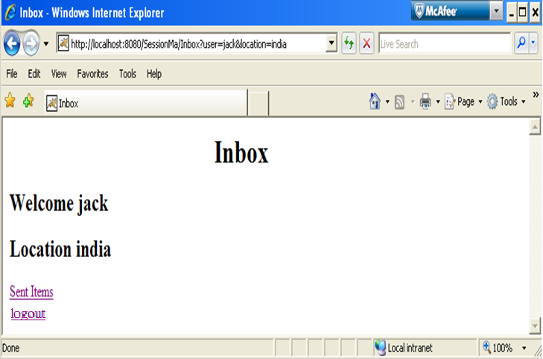
Lend a Hand- Inbox ScreenShot

Slide 59
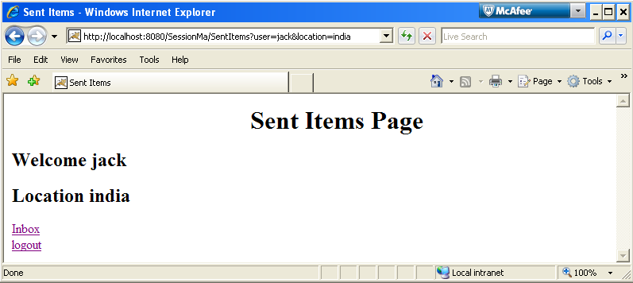
Lend a Hand – Sent Items Screenshot

Slide 60
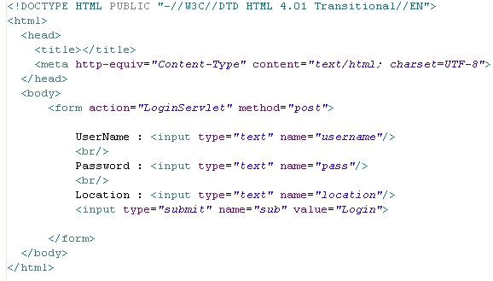
Lend a Hand: Develop a Login html
Develop the Login HTML as mentioned below, It should have the following fields,
User Name
Password
Location , submit action should be the LoginServlet.

Slide 61
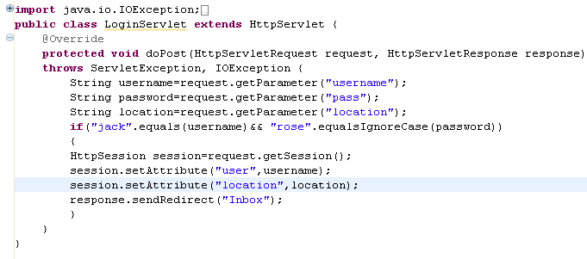
Lend a Hand: Develop a Login Servlet
Develop the login servlet which access the session and sets the attributes user name and location in the session and redirects the request to inbox.
Gets the session object from the request
Sets attribute to session

Slide 62
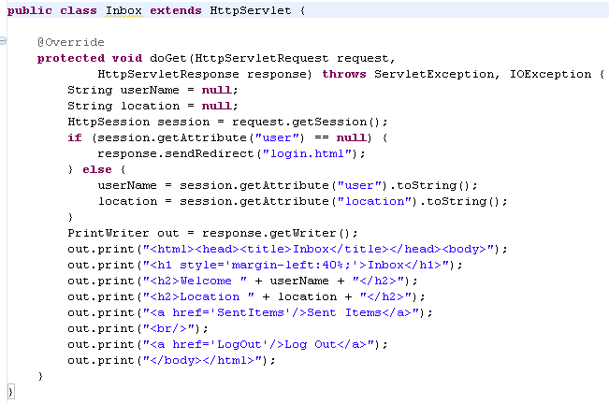
Lend a Hand: Develop a Inbox Servlet
Inbox Servlet should access the attributes and if the attributes are not set it will redirect to the login page.
Reads the session attribute. If attribute not set (user not logged in) it redirects to login page.
Reads the session attribute user name/Location and used for displaying it in the page.

Slide 63
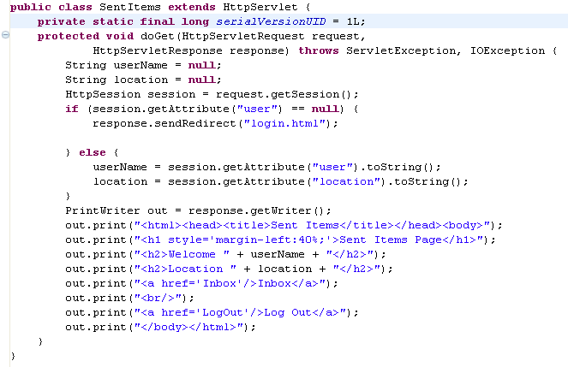
Lend a Hand: Develop a Sent Items Servlet
Similar to inbox servlet the sent item servlet read the values from the session, checks for login if not redirects to login HTML and displays the user name and location.

Slide 64
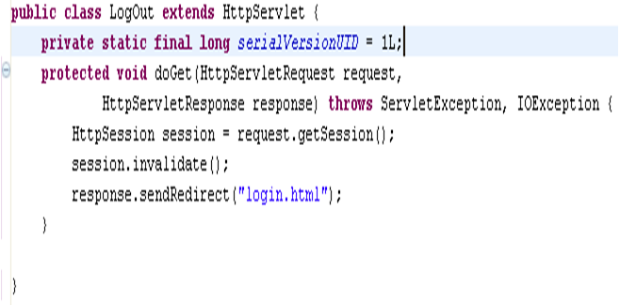
Lend a Hand: Develop a Logout Servlet
When the logout link is clicked this servlet will be accessed and will clear the session using invalidate method and remove the attribute user.
Invalidates the session object. Invalidating the session removes the entire session object and hence the entire set of session attributes.

Slide 65
Lend a Hand: Deploy and Run
Step 1 : Deploy the application.
Step 2: Try to call Inbox from browser.
http://localhost:8080/Session/Inbox
You will see that you will be redirected to the login.html page since you haven’t logged in and hence session value is not set.
Step 3 : Enter the details in login.html and press login. You will be redirected to Inbox page where the welcome message is displayed with the location and user name.
Step 4 : Click Sent Items link and you can see sent items page where the welcome message is displayed with the location and user name.
Step 5 : Click logout link in any of the pages. You will be redirected to login.html.

Slide 66
Tips on Using Session Object
Session objects are stored in server and it utilizes memory. So store only the needed information in sessions. Avoid bulky objects in session this can result in “out of Memory Error” resulting in a application crash.
Whenever a user closes the browser or logs out of the web application remove the session attributes set using the invalidate() and remove() API’s.

Slide 67
Pros and Cons of Using Http Session
Pros :
Simple to use since managed in the server.
Can function even when the cookie functionality is turned off in the browser.
Cons :
Since session objects are stored in the server the server memory required is more which is costly.

Slide 68
General Tips for using session Management Techniques.
Typically in Projects we use Session technique for holding the user attributes.
Cookies are rarely used as there could be users accessing browsers without cookie support.
If there is some state which is maintained in one or few pages, we use URL rewriting or hidden fields.
Most Importantly never load session object with bulky objects. Load only the states which are used across the web application.

Slide 69
Attribute Scopes in Servlet
Application
All servlet/jsp in the web application have access.
Available for the life time of the application.
Session
Available to all servlets/jsp that have access to the specific session.
Available for the life time of the session.
Request
Available to servlets/jsp that have access to this specific request.
Available for the life of the request that is until response send to client.
Achieved by storing in the ServletContext object
Achieved by storing in the HttpSession object
Achieved by storing in the HttpServletRequest object

Slide 70
SERVLETS
You have successfully completed -
Servlet Session Management

